Slide 1
Exploring Diabetes Status
Annabelle, Arav, Lily, Sam

Slide 2
The DS Problem
Given the CDC's dataset on certain factors associated with diabetes, we must build a machine learning model that can classify individuals and their expected diabetes diagnostic status. The factors that we get to work with include, diabetes status, whether they have high blood pressure, check their cholesterol, smoke, have had a stroke, have had heart disease or an attack, exercise, eat fruits and veggies, heavily consume alcohol, have healthcare, can afford healthcare, have difficulty walking, are male or female, as well as their general physical and mental health status, age group, education level, income level, and BMI.

Slide 3
Data Prepping
Fix incorrect data types
Handle missing values
Handle outliers

Slide 4
Category Type Variables
The categorical types that we are dealing with (Diabetes_012, Age, GenHealth, Education, Income) are all ordinal, with a set position that matters in relation to the other values; they are "levels" with linear progressions. For example, for Income, a category of 1 represents a salary of less than 10,000 dollars, 2 represents less than 35,000 dollars, et cetera. To a machine learning algorithm with no preexisting understanding for the significance of a specific salary, the only distinction between an actual dollar amount and a level representation is the degree of specificity. This will be useful when we encode these categorical type variables as integers later in this problem. For the purposes of data cleaning, I will also consider MentHlth and PhysHlth categorical/ordinal types in this same way due to their relatively small domain (1 - 30).

Slide 5
Binary Variables
There are many binary variables including HighBP, CholCheck, Smoker, Stroke, HeartDiseaseorAttack, PhysActivity, Fruits, Veggies, HvyAlcoholConsump, AnyHealthcare, NoDocbcCost, DiffWalk, and Sex. These may either be 1 or 0, and indicate a presence or lack of certain behaviors and conditions. I decided to transform these into booleans.

Slide 6
Continuous Integers
BMI cannot be 0, but does not technically have an upper limit.

Slide 7
Findings

Slide 8
Findings
Diabetes_012: The chart indicates that the majority of individuals in the dataset do not have diabetes, with a smaller proportion having type 2 diabetes and an even smaller proportion having type 1 diabetes.
HighBP: The chart shows that more individuals in the dataset do not have high blood pressure compared to those who do. However, there is still a significant number of individuals with high blood pressure.
HighCol: Similar to the high blood pressure chart, the majority of individuals do not report having high cholesterol, although a substantial minority does.

Slide 9
Findings
CholCheck: The vast majority of individuals in this dataset have had their cholesterol checked within the past five years.
NoDocBcCost: Most individuals in the dataset did not encounter difficulties obtaining medical care due to financial constraints.
Smoker: The majority of individuals in the dataset are non-smokers, although a considerable minority are smokers.
Stroke: A relatively small proportion of individuals in the dataset reported having experienced a stroke.
HeartDiseaseOrAttack: A relatively small proportion of individuals in the dataset reported having heart disease or experiencing a heart attack.

Slide 10
Findings
PhysActivity: The majority of individuals in the dataset report engaging in physical activity.
Fruits: Most participants report consuming fruit at least once per day.
Veggies: An even larger proportion of participants report daily vegetable consumption.
HvyAlcoholConsump: A small proportion of individuals in the dataset report heavy alcohol consumption.
AnyHealthcare: An overwhelming majority of participants have access to healthcare.

Slide 11
Findings
GenHlth: The chart approximates a normal distribution with a slight right skew, peaking at a self-reported “Very Good” overall health rating. This suggests that most individuals consider their general health to be very good.
PhysHlth: The chart indicates that the majority of individuals reported no days of poor physical health in the past 30 days. Some individuals reported a few days of poor health, while a notable minority experienced poor health every day.
MentHlth: Similar to physical health, most individuals reported no days of poor mental health, with a smaller subset reporting a few days of poor mental health and a significant minority reporting poor mental health every day.
Sex: The majority of individuals in the dataset are female.

Slide 12
Findings
Age: The chart is slightly left-skewed, suggesting that the dataset is composed predominantly of older age groups. Representation declines sharply in the oldest age groups, suggesting middle-aged adults make up the largest segment of the dataset.
Education: The chart is heavily left-skewed, indicating that the sample predominantly consists of well-educated individuals. The largest group has at least a bachelor’s degree (level 6), followed by individuals with some college education and high school degrees. Representation decreases significantly below these education levels.

Slide 13
Findings
Income: Income distribution follows an upward exponential trend, with the largest group earning over $75,000 annually. Higher income levels are more prevalent in the dataset.
DiffWalk: The majority of individuals in the dataset report no difficulty walking.
BMI: The BMI distribution is approximately normal but slightly right-skewed, with a mean BMI between 25 and 30. The longer right tail indicates more extreme cases of obesity compared to undernutrition.

Slide 14
Correlation Matrix
Moderate relationships are established in the data:
General Health and Physical Health (r=0.52): A moderate positive correlation exists between general health and the number of days of poor physical health. This suggests that individuals who report worse general health are more likely to experience more days of poor physical health.
Physical Health and Difficulty Walking (r=0.48): There is a moderate positive correlation between poor physical health and difficulty walking. This implies that individuals experiencing more days of poor physical health are also more likely to report serious difficulties walking or climbing stairs.
General Health and Difficulty Walking (r=0.46): General health is moderately correlated with difficulty walking, indicating that individuals with worse overall health are more likely to report walking difficulties.
Education and Income (r=0.45): A moderate positive relationship between education level and income suggests that higher levels of education are generally associated with higher income levels.

Slide 15
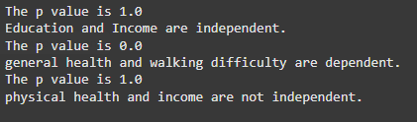
Feature Picking
We found that general health and walking difficulty are statistically significant.
Also, from the previously mapped out correlation, we can see that for diabetes, the features with the MOST POSITIVE correlations were general health and high blood pressure. Then, the features with the MOST NEGATIVE correlations were income, education and physical health.
So from this information, we can deduce that the best features for our model that can help us predict diabetes are general health, high blood pressure, income, education and physical health.

Slide 16
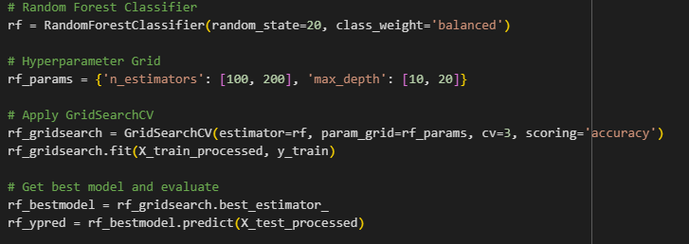
Building the ML Models
Random Forest Classifier
Support Vector Classifier
K-Nearest Neighbors
Logistic Regression

Slide 17
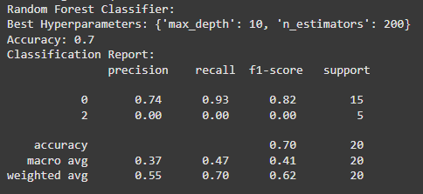
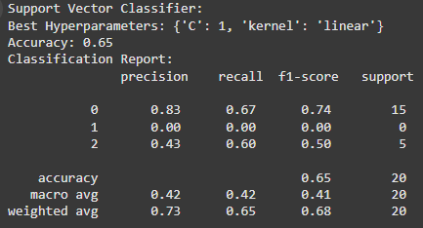
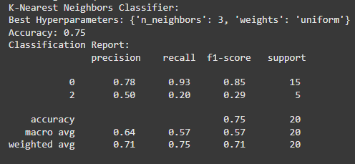
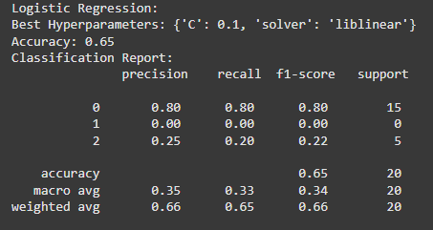
Results

Slide 18
Results
Random Forest
For the Random Forest Classifier, the best model achieved an accuracy of 0.7 with hyperparameters max_depth: 10, n_estimators: 200. However, the model showed significant bias; it performed well on the majority class (precision: 0.74, recall: 0.93 for class 0) but poorly on minority classes (e.g., no positive recall for class 2). This imbalance shows that while the model captures overall patterns, it struggles with bias, which makes it less suitable for healthcare applications.
K-Nearest
The K-Nearest Neighbors (KNN) Classifier, with hyperparameters n_neighbors: 5, and uniform weights, achieved a higher accuracy of 0.830. However, its performance across classes reveals limitations in recall and f1-score for minority classes, with class 1 recall being almost zero. Much like in the Random Forest algorithm's case, it struggles heavily with bias.

Slide 19
Results
Logistic Regression
The Logistic Regression model, using C: 1 and a liblinear solver, achieved the highest accuracy at 0.837. While it outperformed other models in terms of overall accuracy and slightly improved minority class performance (class 2 precision: 0.39), the recall and f1-score for minority classes are still weak. The macro averages (f1-score: 0.33) demonstrate that it is poor at handling class imbalance effectively.
Overall comments
In this context, metrics like precision, recall, and f1-score are more important than accuracy, because accurately identifying minority cases (e.g., diabetes positive) is the whole point of the algorithm. The models have high bias for minority outcomes, and may need more tuning.

Slide 20
Bias
This analysis would help physicians and other health care providers better understand the relationship between diabetes and other lifestyle and health factors, which they might then share with their patients. This could assist patients be more ready for what to expect and help them learn the best way to deal with a patient. The lack of correlation our data indicates between diet and diabetes, despite the fact that there is one, raises concerns about bias based on our previous work. People may feel compelled to claim to lead healthier lives than they actually do, and this may be the result of the methods used to collect the data, which could lead to inaccurate data. Analyzing data from certain groups—such as age and sex—in the context of the entire rather than their subset raises additional concerns. Everyone would benefit from taking our model's predictions (which utilize the full sample as references) cautiously if the model were to provide a more accurate forecast based just on the relevant subgroup rather than the full sample.

